Slide 1
Big Data Project On Yelp Dataset
Discover Nice Neighborhoods From Yelp Restaurant Features and Reviews Using Big Data Techniques
Team Members: Cheng Hou, Le Xu, Xiaomeng Dong, Yubo Li

Slide 2
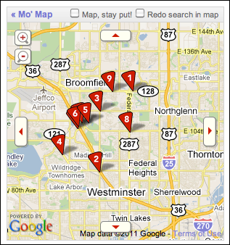
Presentation Outline
Dataset Introduction
Data processing
Data Analysis
Current Work

Slide 3
Five Yelp Datasets We Used:
* Business Dataset
77.3 MB
{ "business_id":"encrypted business id", "name":"business name", "neighborhood":"hood name", "address":"full address", "city":"city", "state":"state -- if applicable --", "postal code":"postal code", "latitude":latitude, "longitude":longitude, "stars":star rating, rounded to half-stars, "review_count":number of reviews, "is_open":0/1 (closed/open),
…
“type”: “business”}
* User Dataset
287 MB
{"user_id":"encrypted user id", "name":"first name", "review_count":number of reviews, "yelping_since": date formatted like
2009-12-19, "friends":["an array of encrypted ids of
friends"], "fans":"number of fans the user has", "elite":["an array of years the user was
elite"], "average_stars":floating point average, ... "type":"user"}

Slide 4
Five Yelp Datasets We Used:
* Review Dataset
2.29 GB
{ "review_id":"encrypted review id", "user_id":"encrypted user id", "business_id":"encrypted business id", "stars":star rating, rounded to half-stars, "date":"date formatted like
2009-12-19", "text":"review text", "type": "review"}
* Tip Dataset
130.7 MB
{"text":"text of the tip", "date":"date formatted like 2009-12-19", "likes":compliment count, "business_id":"encrypted business id", "user_id":"encrypted user id", "type":"tip"}
* Check-in Dataset
28 MB
{ "time":["an array of check ins with the format hour-day:number of check ins from hour to hour+1"], "business_id":"encrypted business id", "type":"checkin" }

Slide 5
Our Goal with Geo-Spatial and Temporal Involvement
Detecting the spatial patterns of businesses according to different features, to better understand the weekly changes and the trends of urban dwellers’ activities.
Use the neighborhood restaurants’ price levels, types, stars ratings, review contents to identify the economical aspects of the neighborhood. (For example: Why Michelin 4 star restaurants are always around the Central Park, Upper East Side? )

Slide 6
Data Processing On Spark
Collect Original data from the website (3 GB)
Separate reviews and check-ins by day (2.3 GB)
Count reviews, check-ins, tips
Aggregate all features by business id

Slide 7
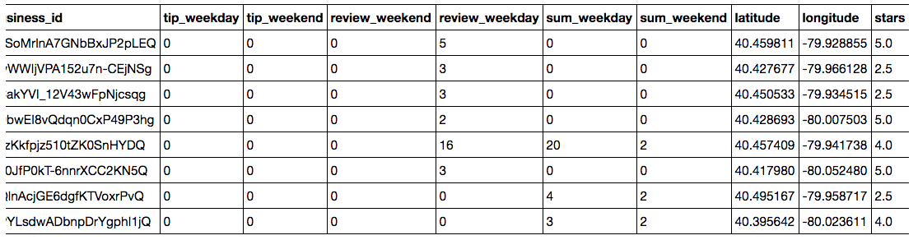
Glance to Our Clean Data
Business id
Ratings
Locations
Review, Tip, Check-in Counts
...

Slide 8
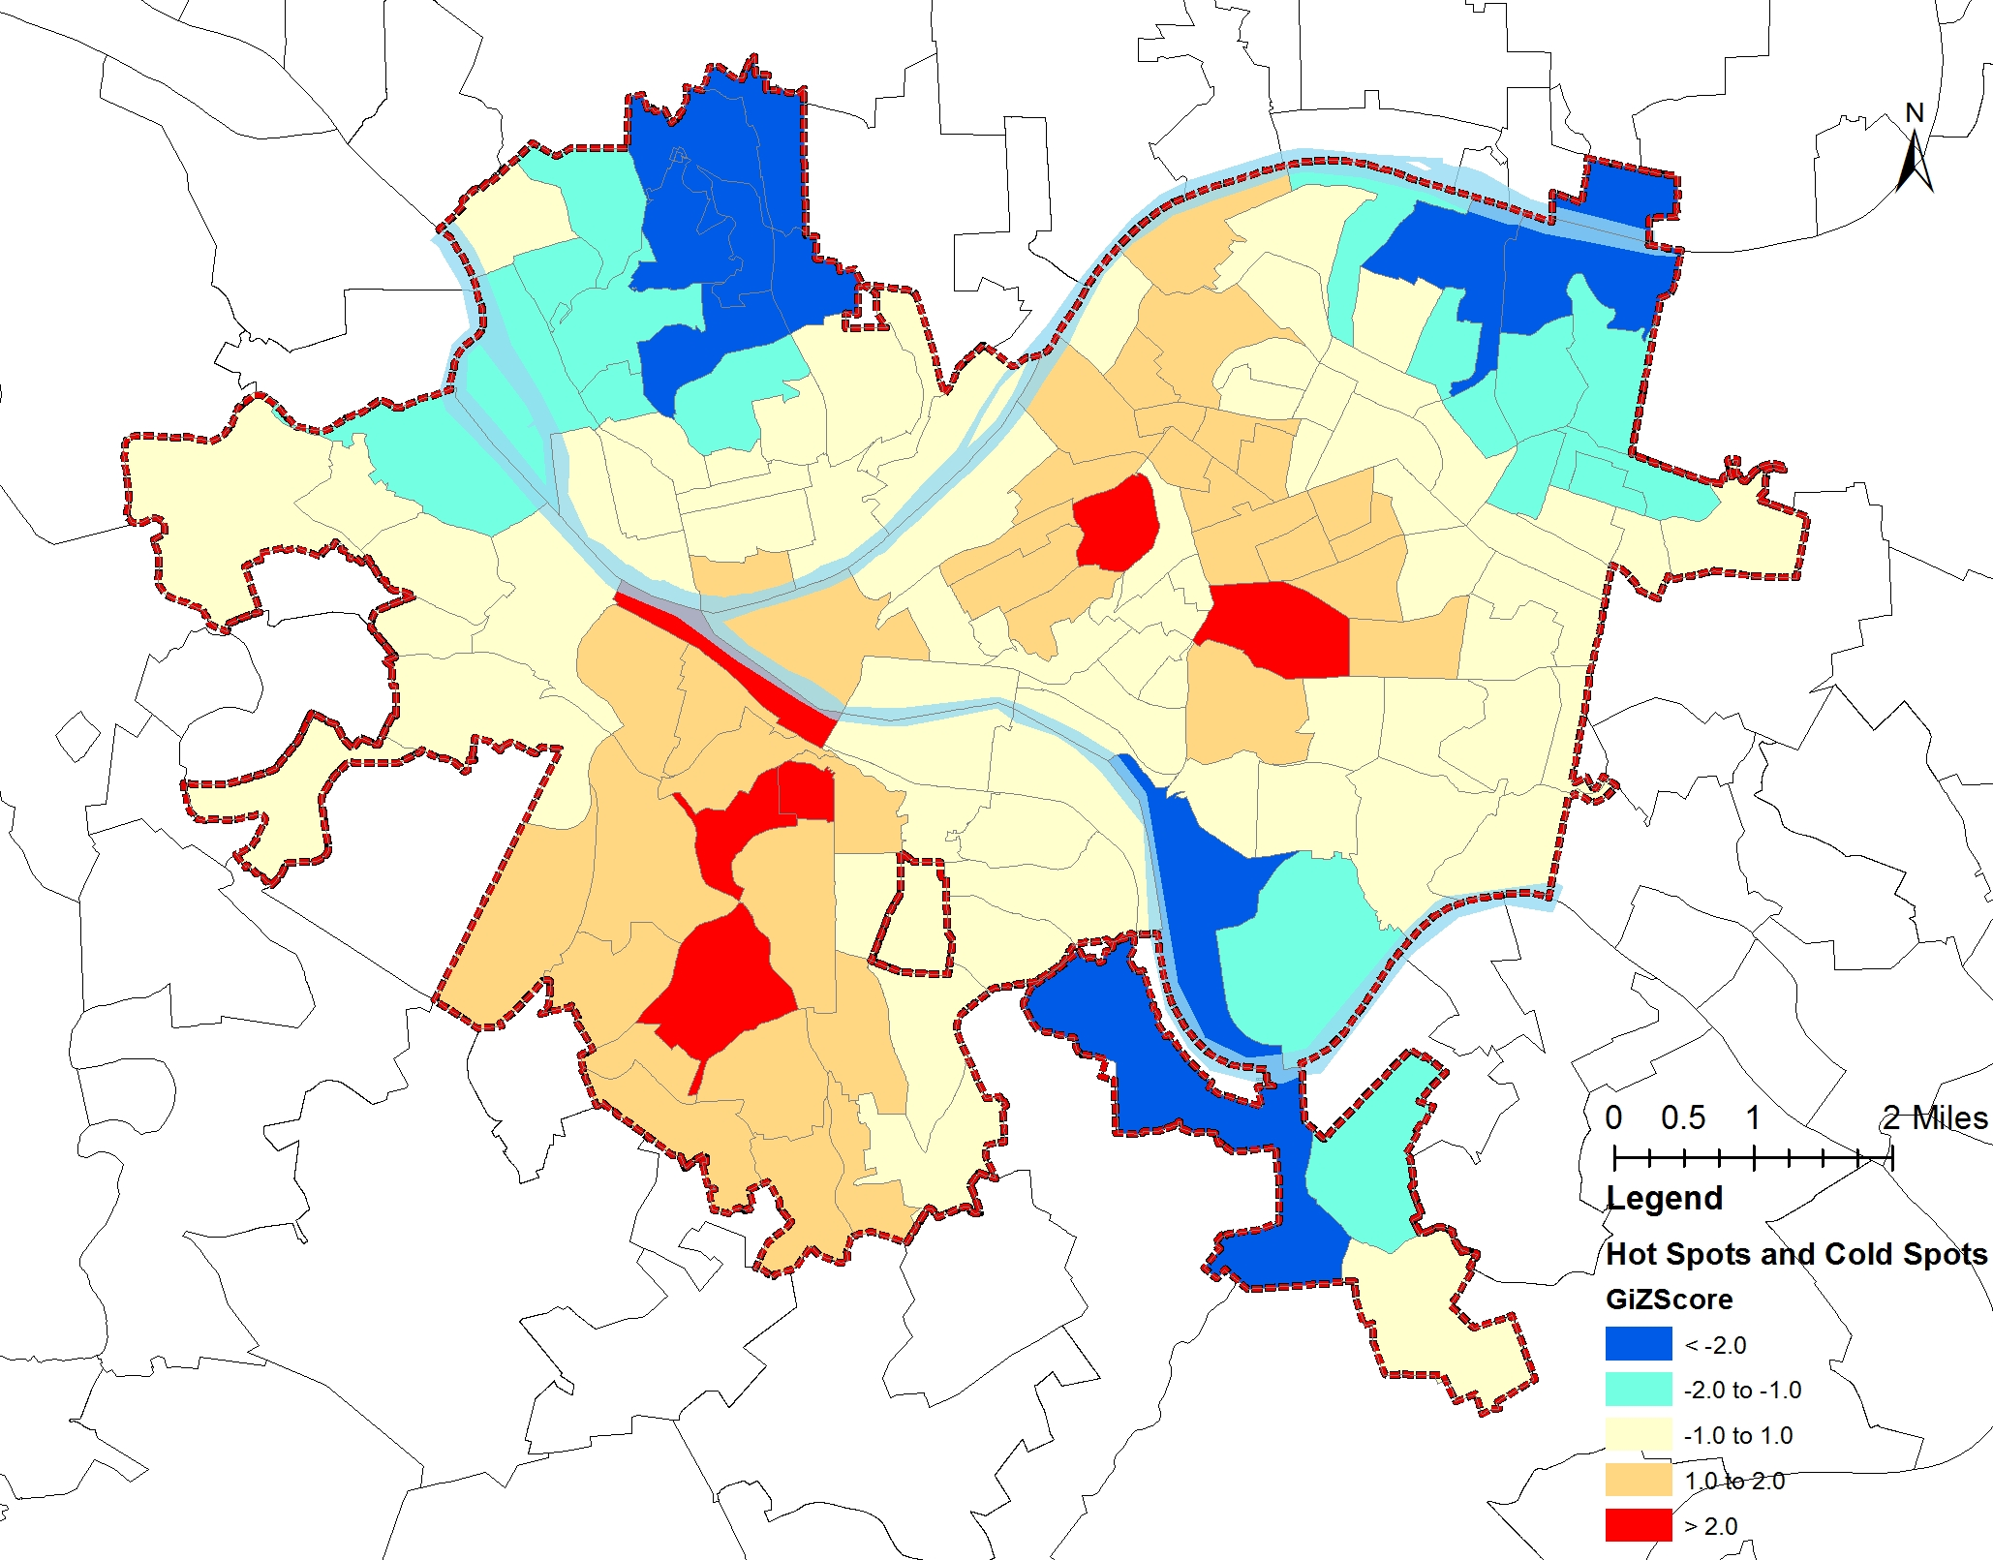
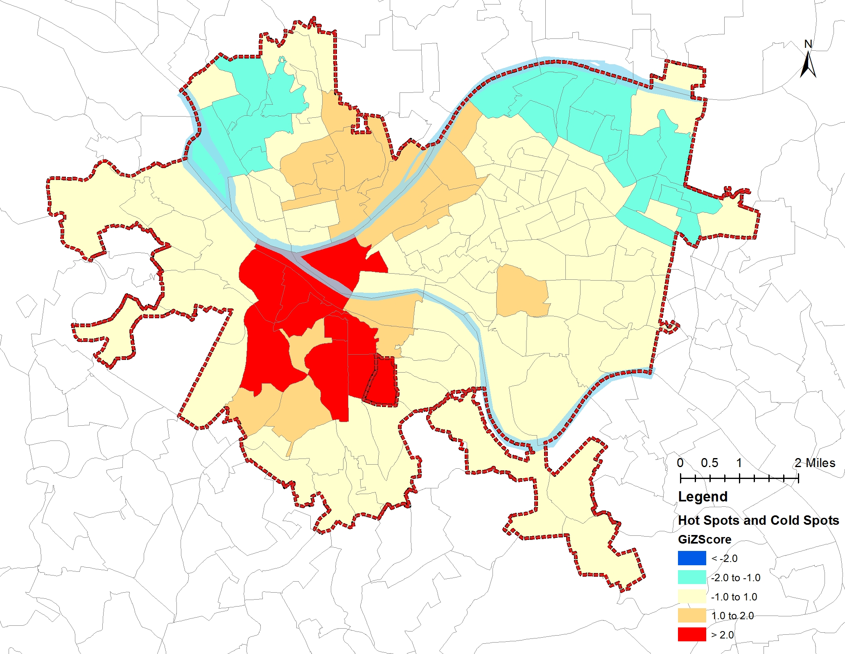
Clustering Restaurants by Hot & Cold Spot
(All ratings ) (4 +Ratings )
GiZScore is the z-scores calculated for the feature of restaurants’ rating
Hot spot means the high value spots are crowded intensely, the same way for cold spot

Slide 9
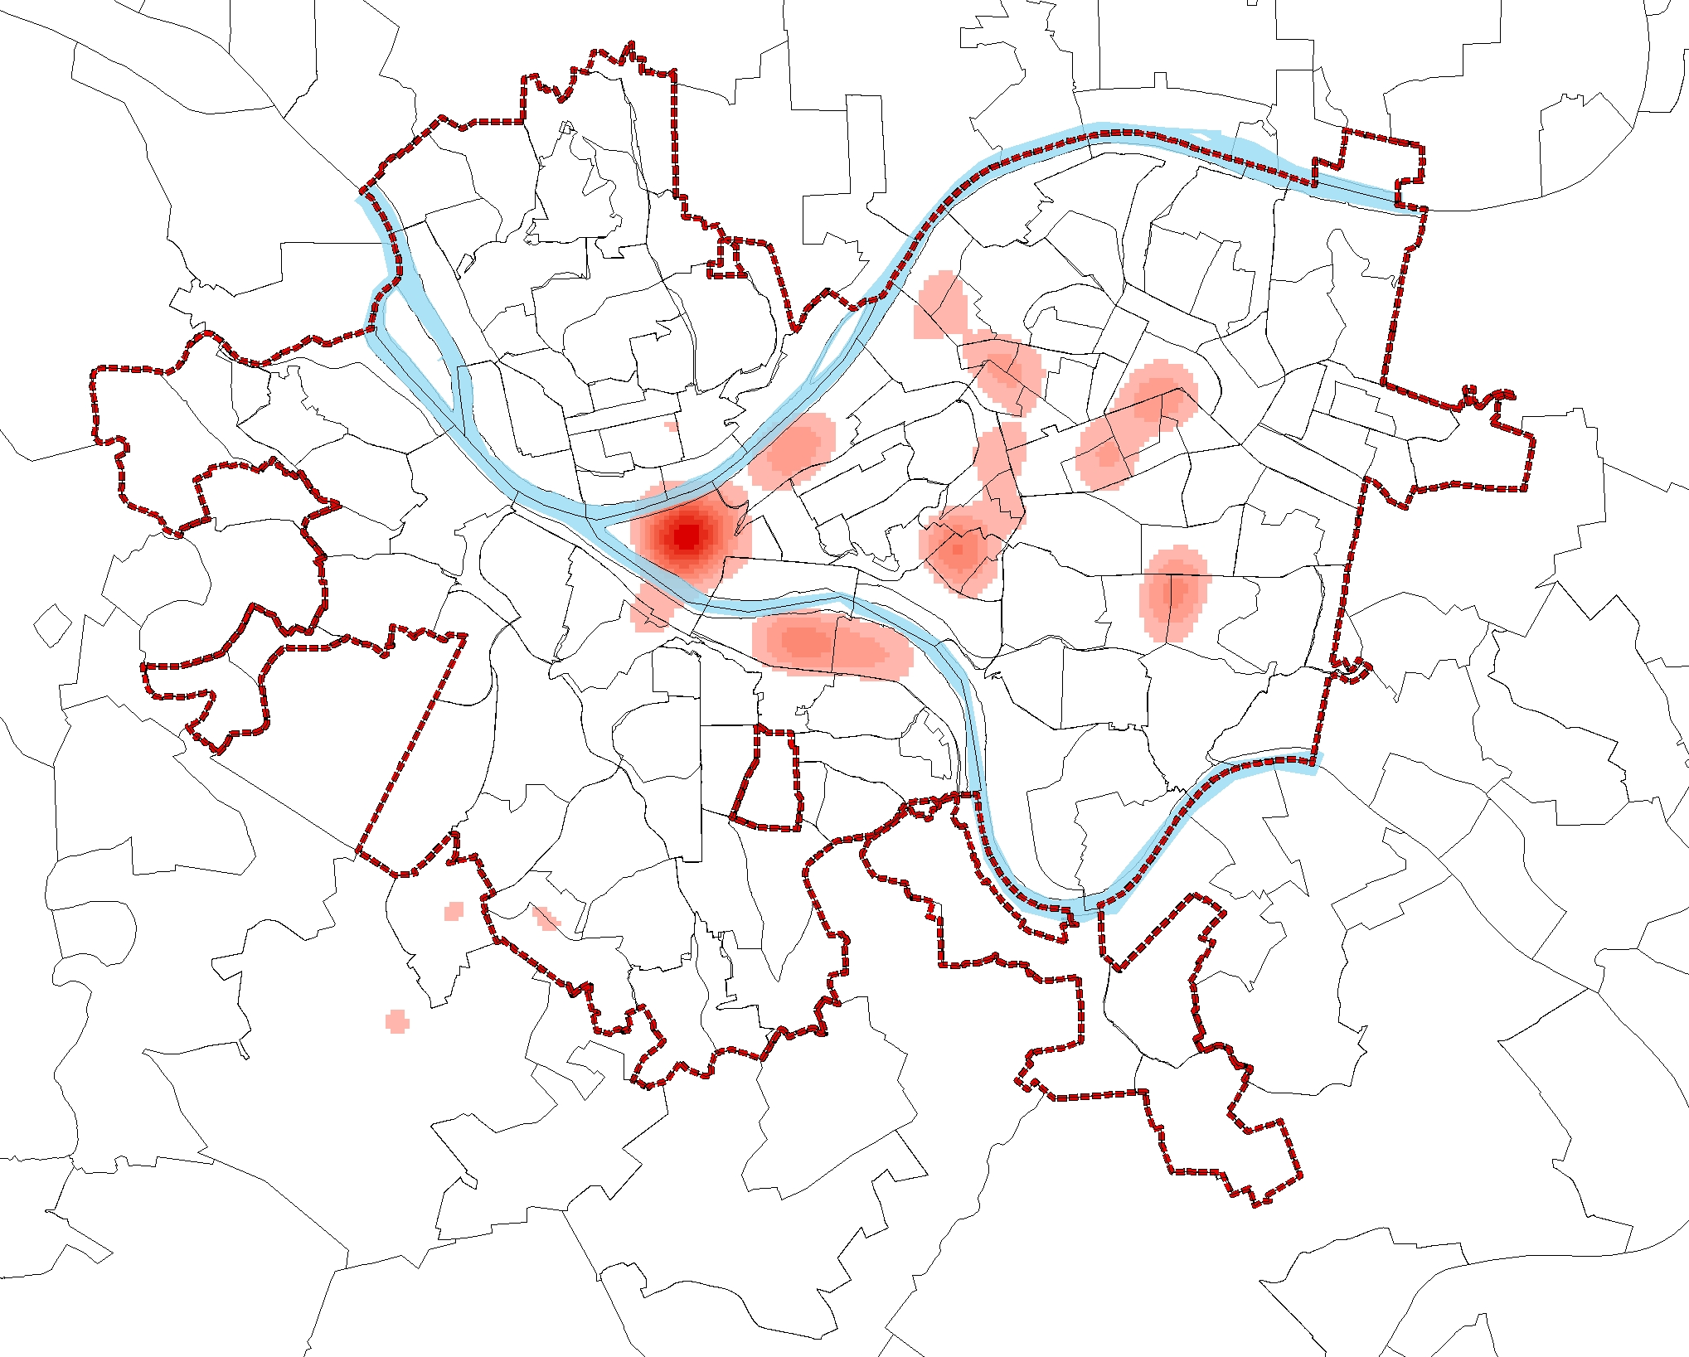
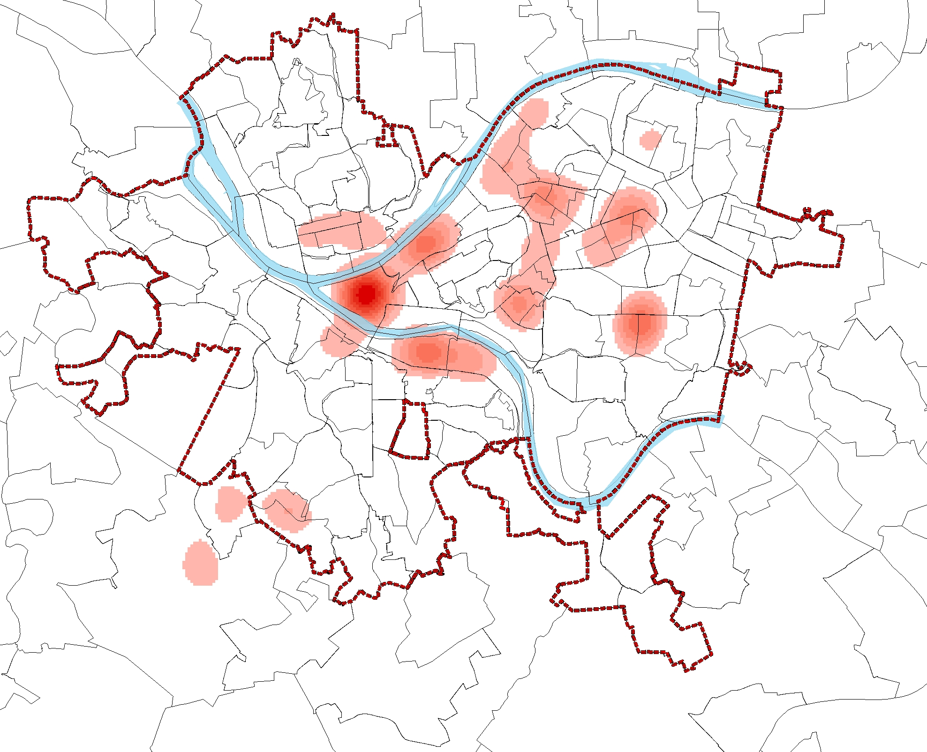
Clustering Restaurants by Kernel Density
(All ratings ) (4 +Ratings )
The contrast shows the similar spatial distributions

Slide 10
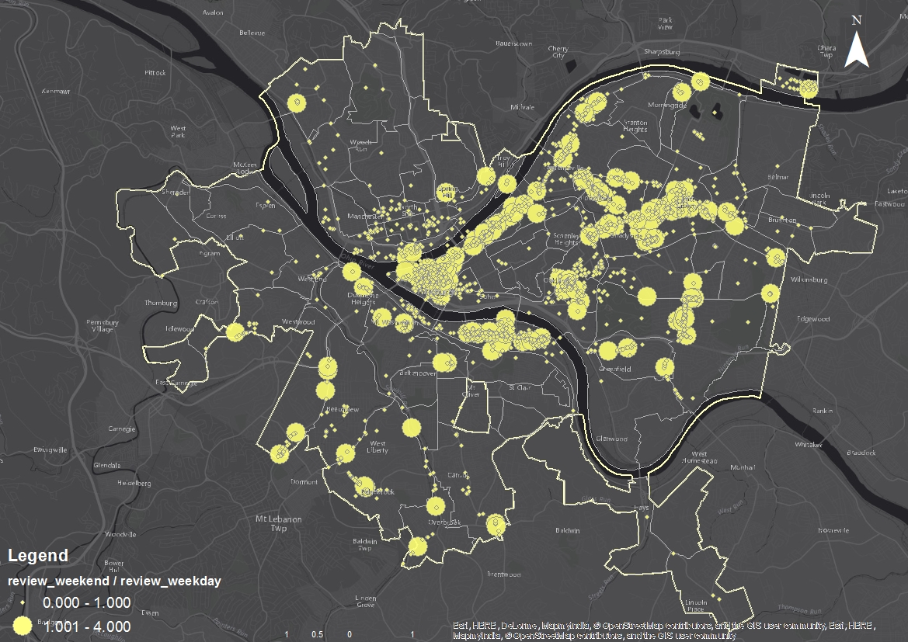
Spatial Clustering: Businesses by Review Counts
Normalized counts
weekends/weekdays
Classified counts
weekends/weekdays <1
Or
weekends/weekdays >=1

Slide 11
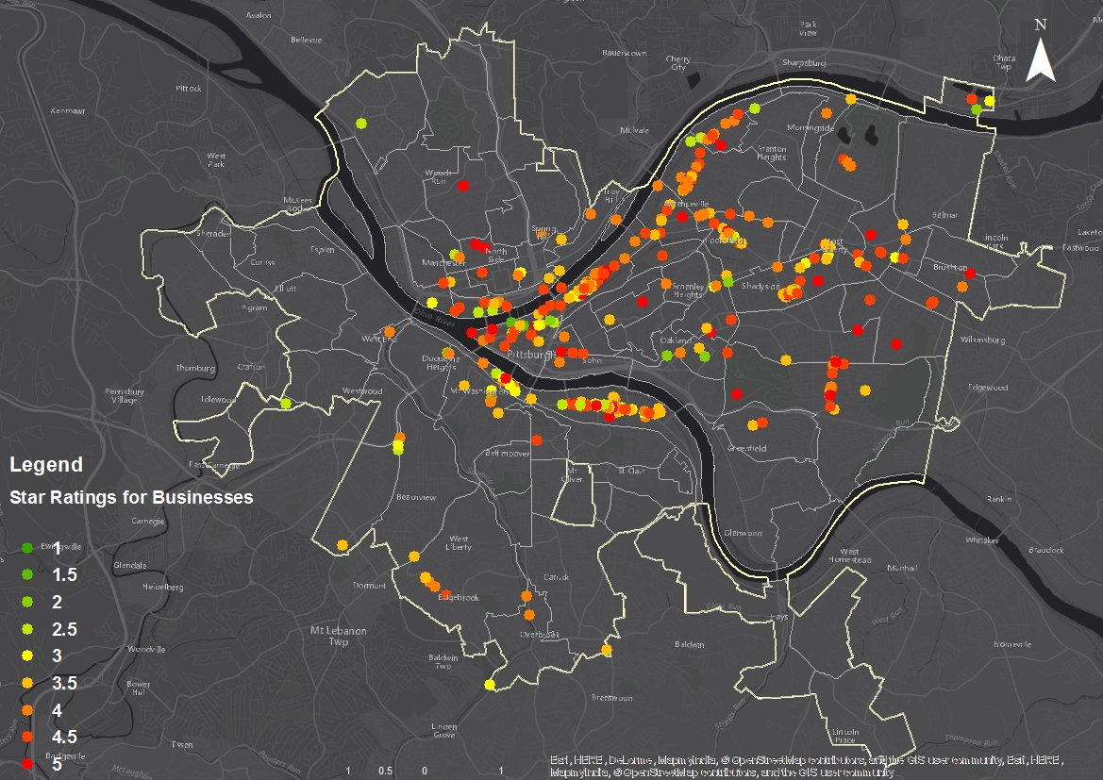
Spatial Clustering: Businesses by Ratings
Filter by check-ins
weekends/weekdays >=1
Cluster by stars
from 1 to 5

Slide 12
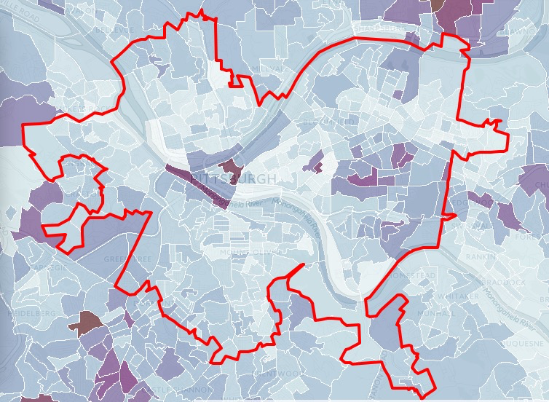

Conclusions
Restaurants around CBD are with more intensive high-ratings
The pattern of high-median income is inconsistent with that of restaurants.
Choropleth map for income in Pittsburgh

Slide 13
What we found:
Several Nice Neighborhoods to Live
## 1609 - Southside Flats
## 0703, 0705 - Shadyside
## 1408 - Squirrel Hill South
## 0405 - Central Oakland
## 0902 - Central Lawrenceville

Slide 14
Comments and Discussion:
The review time does not necessarily represent the time of the dining experience took place.
This Yelp Datasets contains many cities, we will conduct same algorithm to other cities to learn different city patterns.
Understanding the review content(special topics, sentiment, ...) can benefit to identify underlying patterns.
The Study can be used for company like Uber or TLC to predict potential pickups around Restaurants, or Urban Planning

Slide 15
Current working for Text Data Analysis
We need to perform text analysis to understand raw text data and identify potential pattern.
Flesch Reading Ease Score: Educational level of reviewer based on review context
Topic modeling: Special Topics
Sentiment Analysis: Sentiment
We will conduct the text analysis on Spark: pyspark.ml.feature.Word2Vec

